Slide 1
Programming with F# Agents
@rachelreese, Rachelree.se

Slide 2
The Actor model is characterized by inherent concurrency of computation within and among actors, dynamic creation of actors, inclusion of actor addresses in messages, and interaction only through direct asynchronous message passing into queues with no restriction on message arrival order.
Wikipedia
What is the Actor Model?

Slide 3
The Actor model is characterized by inherent concurrency of computation within and among actors, dynamic creation of actors, inclusion of actor addresses in messages, and interaction only through direct asynchronous message passing into queues with no restriction on message arrival order.
Wikipedia
Concurrent

Slide 4
The Actor model is characterized by inherent concurrency of computation within and among actors, dynamic creation of actors, inclusion of actor addresses in messages, and interaction only through direct asynchronous message passing into queues with no restriction on message arrival order.
Wikipedia
Everything is an actor

Slide 5
The Actor model is characterized by inherent concurrency of computation within and among actors, dynamic creation of actors, inclusion of actor addresses in messages, and interaction only through direct asynchronous message passing into queues with no restriction on message arrival order.
Wikipedia
Dynamic creation

Slide 6
The Actor model is characterized by inherent concurrency of computation within and among actors, dynamic creation of actors, inclusion of actor addresses in messages, and interaction only through direct asynchronous message passing into queues with no restriction on message arrival order.
Wikipedia
Addresses
Notes:
An actor can only communicate with another actor whose address it has.

Slide 7
The Actor model is characterized by inherent concurrency of computation within and among actors, dynamic creation of actors, inclusion of actor addresses in messages, and interaction only through direct asynchronous message passing into queues with no restriction on message arrival order.
Wikipedia
Asynchronous

Slide 8
The Actor model is characterized by inherent concurrency of computation within and among actors, dynamic creation of actors, inclusion of actor addresses in messages, and interaction only through direct asynchronous message passing into queues with no restriction on message arrival order.
Wikipedia
Messages

Slide 9
The Actor model is characterized by inherent concurrency of computation within and among actors, dynamic creation of actors, inclusion of actor addresses in messages, and interaction only through direct asynchronous message passing into queues with no restriction on message arrival order.
Wikipedia
Queueing

Slide 10
The Actor model is characterized by inherent concurrency of computation within and among actors, dynamic creation of actors, inclusion of actor addresses in messages, and interaction only through direct asynchronous message passing into queues with no restriction on message arrival order.
Wikipedia
Order

Slide 11
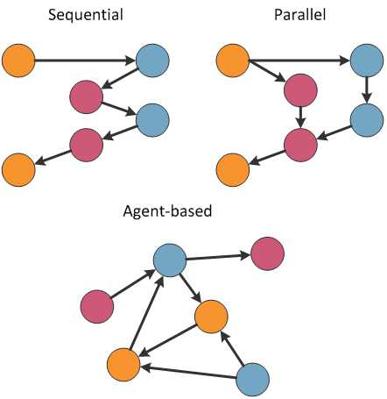
Concurrent architectures
Sequential: single-input/single –output, single track.
Parallel: single-input/single-output, potentially multiple internal tracks.
Agent-based: Multi-input/multi-output.
Notes:
No global state to actor-based.

Slide 12
Behavior
An actor is a computational entity that, in response to a message it receives, can concurrently:
send a finite number of messages to other actors;
create a finite number of new actors;
designate the behavior to be used for the next message it receives.

Slide 13
Actors/Agents in F#

Slide 14




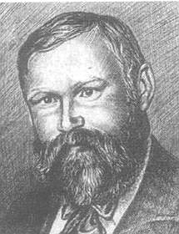
In the beginning, there was Erlang.
(In F#’s history, there was also Axum.)
Notes:
Erlang is a later language.
These are early adopters:
Act 1, 2 and 3
Acttalk
Ani
Cantor
Rosette

Slide 15
Programming with F# Agents
@rachelreese, Rachelree.se

